Slide 1
Spot the differences
Interface Develop

Slide 2
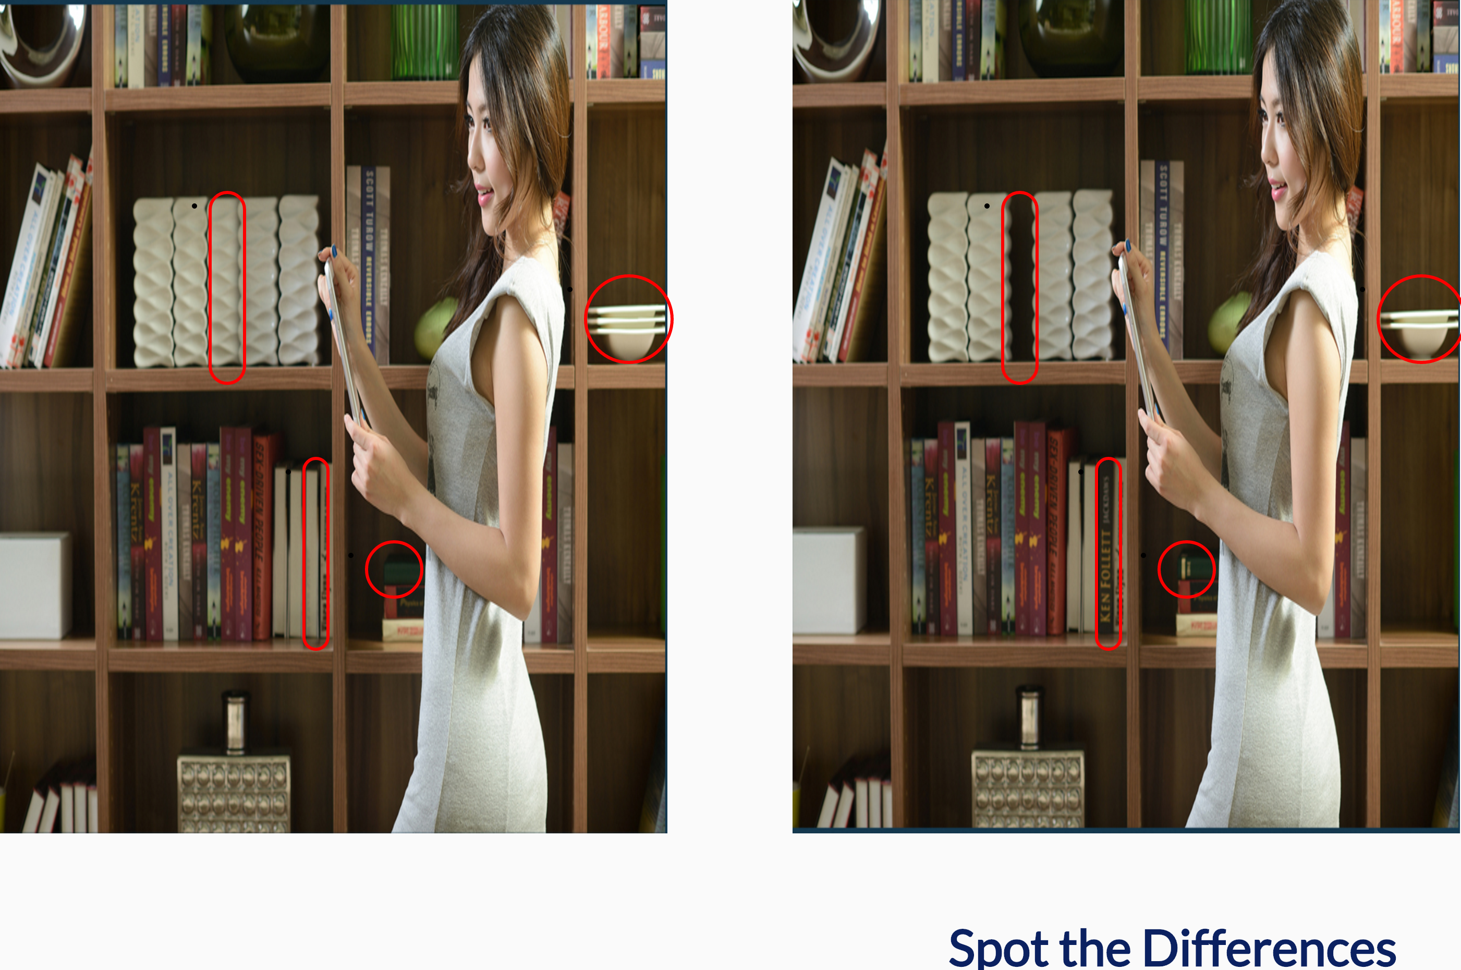
Find 4 differences between two similar pictures
Example

Slide 3
Basic of game rules
The game has 5 levels
Total 90 second
After 5 levels you will win the game.
After 90second you will lose the game.

Slide 4
Challenges I faced
The most difficult one was the to show spot of differences part because I didn’t know how to select specific both left and right sided of ‘li’ at the same time in JQuery like , [data-pair] .
Other difficult part was the change level part

Slide 5
The features I might want to add
I would add Scores instead just having 5 levels so I can add more levels and difficulty mode and also highest scores.
I would add start page and play again features.
I would add hint features for people who stuck at one level.
I would add pause features
I would add level for my interface so players know what level they are at.

